Slide 1
Logistic Regression
Le Hoang Nam
namlh@hanu.edu.vn

Slide 2
What is logistic regression?
Logistic regression is a process of modeling the probability of a discrete outcome given an input variable.
The most common logistic regression models a binary outcome; something that can take two values such as true/false, yes/no, and so on.
Multinomial logistic regression can model scenarios where there are more than two possible discrete outcomes.

Slide 3
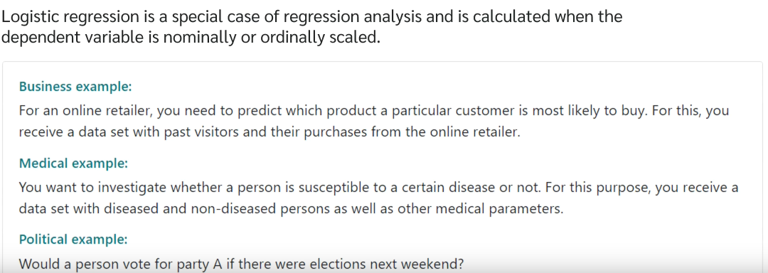

Slide 4
Examples
Email sent to your mailbox is spam or not?
A patient is positive or negative to cancer?
Should I invest in this company or not?
This is a dog or a cat?

Slide 5
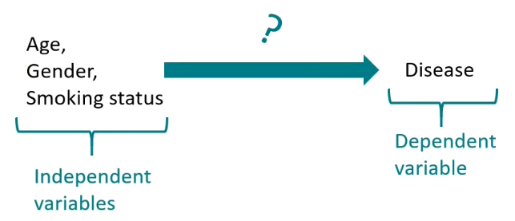
In medicine, for example, a common goal is to find out which variables have an impact on disease.
In this case, 0 stand for “not diseased” and 1 stand for “diseased”
And the influence of age, gender, smoking status on this particular disease is examined.

Slide 6
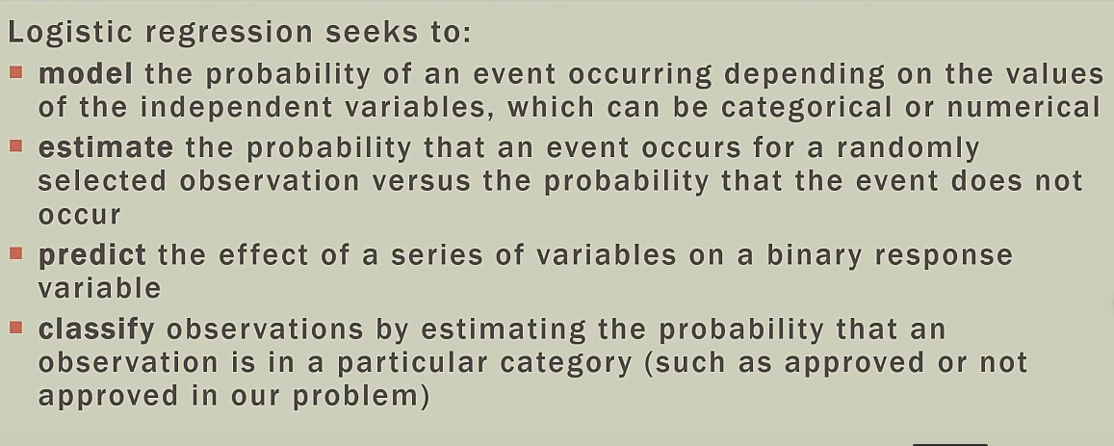

Slide 7
Problem
The bank has a loan program for apartment buyers.
Normally you can go through 10-20 applications a day to decide, but lately you are receiving 1000-2000 applications per day.
You can't process all the applications and you need a solution to predict the new application as to whether to lend or not.

Slide 8
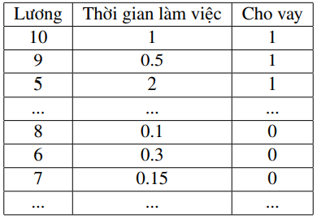
After analyzing, you find that the two main factors that determine whether to get a loan are salary and working time. Here is the data you have so far:

Slide 9
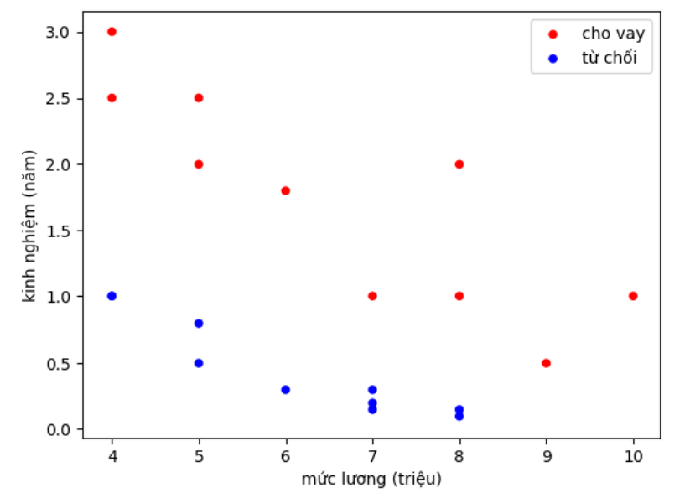

Slide 10
Logically, we need to find the dividing line between the lending and rejection points. Then decide whether to apply for a new loan or not from that line.

Slide 11
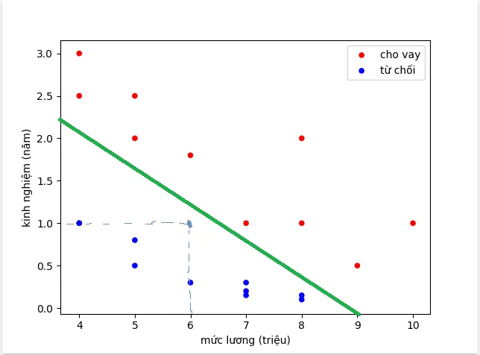
For example, the green line is the dividing line. Predictions for the profile of someone with a salary of 6 million and 1 year of experience is not lending.

Slide 12
However, because the bank is in a difficult period, the lending is tightened, only those documents with more than 80% certainty can get a loan.
So now you are not only looking for a loan or not, but you need to find out how much you should lend to that profile.
=> Probability

Slide 13
Probability
What is Probability???
According to the wiki, "Mathematicians consider probabilities to be numbers in the range [0,1], assigned to an event for which the probability of occurring or not occurring is random".
For example, if you toss a coin with 2 faces, then the probability of you tossing heads is 50% (= 50/100 = 0.5).

Slide 14
Probability
Probability of an event in the interval [0,1]
The more likely the event you are to happen, the higher the probability.
The sum of the probabilities of event A and the negative event of A is 100% (or 1).
Example event A: toss a coin heads, probability 50%; negative event A: toss a coin heads, probability 50% => total 100%

Slide 15
You will find the probability is more important than just 0 or 1, for example before each difficult operation, the doctor cannot be sure whether it will fail or succeed but can only say what the probability of success is (eg. 80%).

Slide 16
Sigmoid function
Now I need to find the confirmation of the new application to lend. Or the value of the function needs to be in the range [0,1].
Obviously, the value of a straight-line equation like the previous one can go outside the range [0,1], so we need a new function that always has a value in the range [0,1].
That is the sigmoid function.

Slide 17
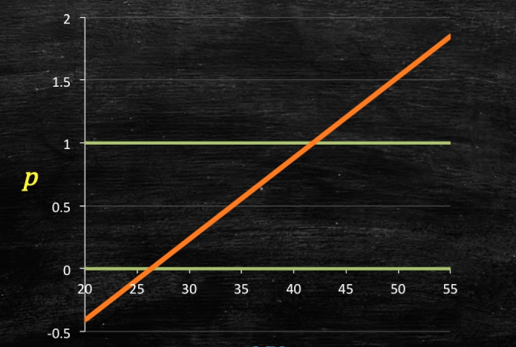

Slide 18
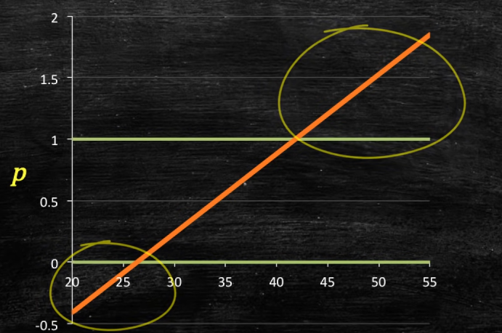

Slide 19
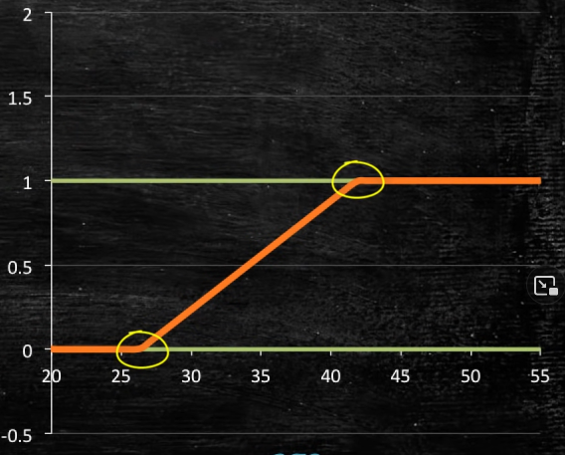

Slide 20
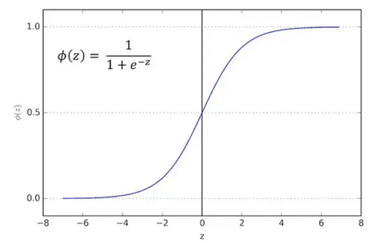
Sigmoid function
Continuous function, taking real values in the interval (0,1).
Function with derivative at every point (to apply gradient descent)

Slide 22
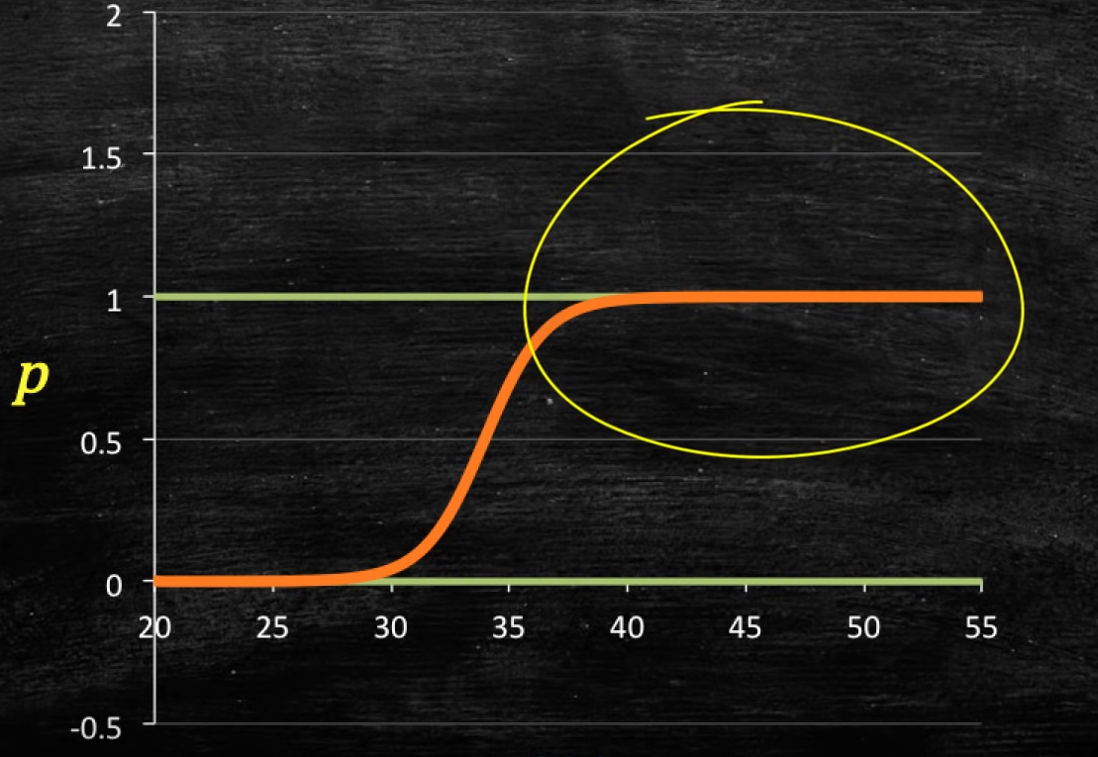

Slide 23
Decision Boundary
We expect our classifier to give us a set of outputs or classes based on probability when we pass the inputs through a prediction function and returns a probability score between 0 and 1.
For Example, We have 2 classes, let’s take them like cats and dogs (1 - dog , 0 - cats).
We basically decide with a threshold value above which we classify values into Class 1 and of the value goes below the threshold then we classify it in Class 2.

Slide 24
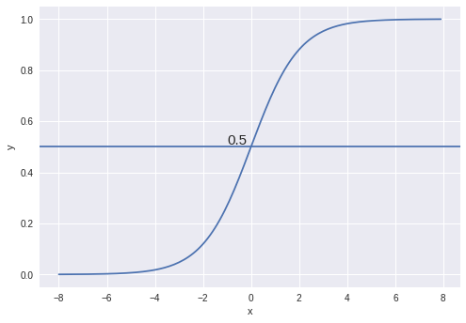
As shown in the above graph we have chosen the threshold as 0.5, if the prediction function returned a value of 0.7 then we would classify this observation as Class 1(DOG). If our prediction returned a value of 0.2 then we would classify the observation as Class 2(CAT).

Slide 25
Solving problem process:
Model setting
Set up loss function
Find the parameter by optimizing the loss function
Predict new data using the model you just found

Slide 26
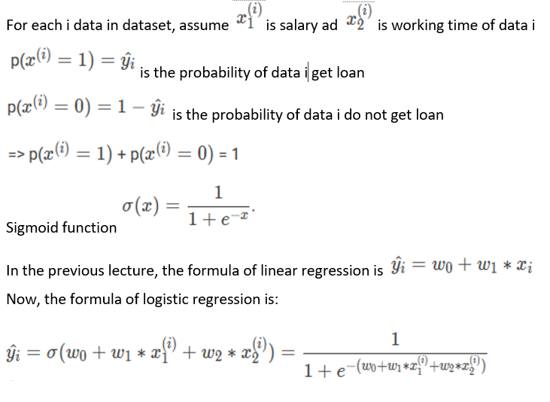
Model:

Slide 27

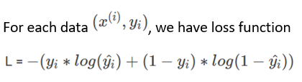
Loss function

Slide 28
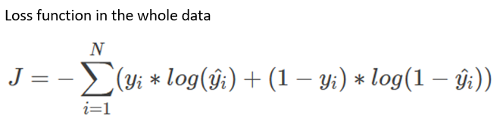

Slide 29
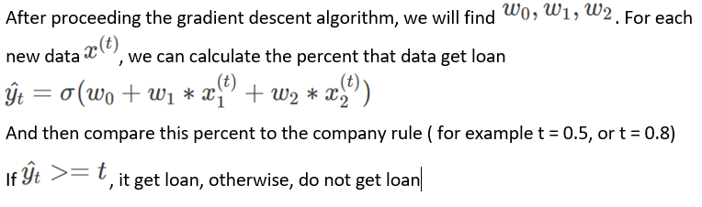

Slide 30
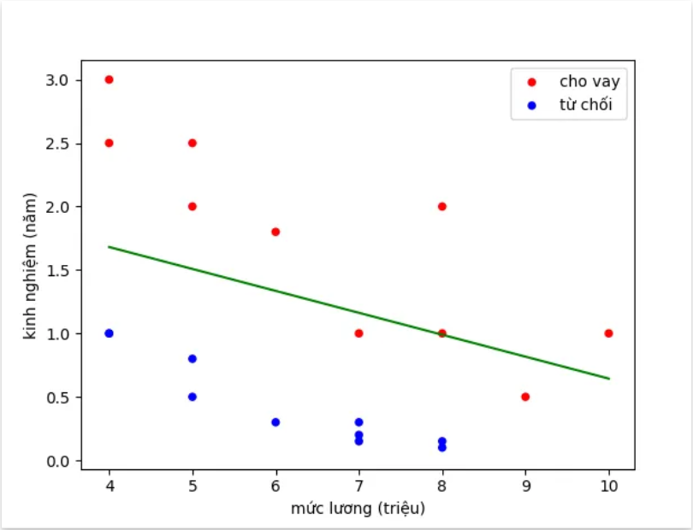

Slide 31
Logistic regression uses the following assumptions:
1. The response variable is binary.
It is assumed that the response variable can only take on two possible outcomes.
2. The observations are independent.
It is assumed that the observations in the dataset are independent of each other. That is, the observations should not come from repeated measurements of the same individual or be related to each other in any way.

Slide 32
3. There is no severe multicollinearity among predictor variables.
It is assumed that none of the predictor variables are highly correlated with each other.
4. There are no extreme outliers.
It is assumed that there are no extreme outliers or influential observations in the dataset.
5. There is a linear relationship between the predictor variables and the logit of the response variable

Slide 33
6. The sample size is sufficiently large.
As a rule of thumb, you should have a minimum of 10 cases with the least frequent outcome for each explanatory variable. For example, if you have 3 explanatory variables and the expected probability of the least frequent outcome is 0.20, then you should have a sample size of at least (10*3) / 0.20 = 150.

Slide 34
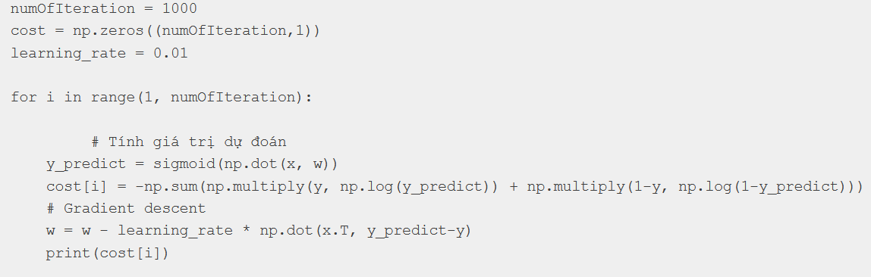
Brief code to find w[0], w[1], w[2]

Slide 35
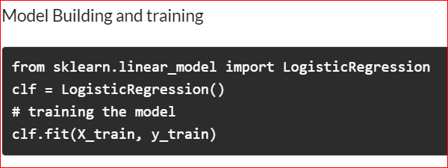
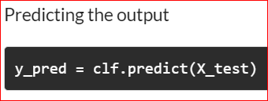
Using sklearn library

Slide 37
Some application of logistic regression
Spam detection: Predict whether the mail sent to your mailbox is spam or not.
Credit card fraud: Predict whether a bank transaction is fraudulent.
Health: Predict whether a tumor is negative or positive.
Banking: Predict whether the loan will be repaid or not.
Investment: Predict whether an investment in a start-up will be profitable or not.

